Slide 1


Mission-Driven Careers
Opportunities await in
older adult services
The Trusted Voice for Aging

Slide 2
Brought to you by:
(add the name/city/logo of your
community here)
We are a member of LeadingAge — a national organization whose 6,000 member communities take care of older adults
Notes:
Welcome!
I’m here from NAME OF YOUR COMMUNITY to talk to you about careers working with older adults
I’ve found that many high school students – like you - don’t always know about this field – and the jobs that are available
Over the next few minutes, I’d like to talk to you about 3 things:
--all the jobs that will be available over the next few years
--the different jobs that you can do – after high school, or, after college
--and, how to find out more information
But FIRST, let me show you a quick video on working with older people.
This video was put together by a group of people in their twenties who found they really liked working in this area
GO TO NEXT SLIDE

Slide 3

Working with Older Adults
What’s the first thing that comes to mind when you think about a career serving older adults?
Notes:
Ask students what they think about working in older adults. Validate the comments they have, there may be a mix of stereotypes and that’s ok.
Share YOUR journey and experience.
What was your career path?
What education did you pursue to get where you are?
Why do you love your job?
Share a story about your work (my favorite resident was…the funniest memory I have of working in Nursing Home ABC was…The most meaningful experience I had with a hospice patient was…)

Slide 4
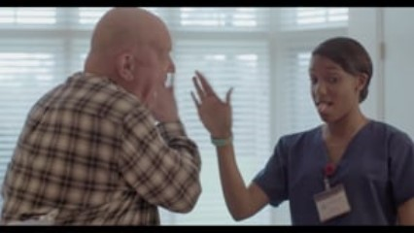

A day in the life of a nursing assistant
Notes:
Discussion:
After seeing that video, what do you think it’s like working with older adults?
Why do you think the staff in that video stay in their jobs as caregivers? Why do they love their career?
The video focused on the roles of caregivers, which is usually the first thing that comes to mind. But the really cool thing about careers in older adult services is that there are so many types of careers you may not expect. Older adults need everything that YOU need in life – they want to have fun and go out for dinner or to a movie; they need to visit the doctor and the dentist; they need to get dressed in the morning; they need to taken medications; they need to clean their homes; they need to do yard work; they need to pay bills…as such, there are professions to help older adults with every aspect of their lives. Let’s take a look at what some of those opportunities are….

Slide 5





Careers with a high school diploma plus training
  Caregivers
    Certified Nursing Assistants (CNAs)
    Home Health Aides (HHA)
    Personal Care Aides (PCA)
  Building and Ground
  Maintenance
  Culinary
  LPNs or LVNs
  Licensed Practical Nurses (LPNs)
  Licensed Vocational Nurses (LVNs)
  Housekeeping
Notes:
What if you aren’t sure what to do right after high school?
With just some on-the-job training, you can become a:
-- Caregiver – These are some of the most important staff in older adult services, because they provide most of the care to the resident or client. Because of this, they often develop close bonds with the clients and find a lot of meaning in what they do. Some caregivers get more training to become nurses, and many LPN or LVN programs are only one year long!
-- You can work in a restaurant. Organizations like nursing homes and assisted livings have cafes, coffee shops, dining rooms, and even full restaurants. These operate like any restaurant here in town – we need cooks, chefs, servers, hosts, bussers, etc. And one of the best parts? We have better hours than a typical restaurant. You don’t have to work until a restaurant closes at midnight – when dinner service is done, get to head home!
--If you like to fix things, work with your hands, build or repair mechanics, then building or grounds maintenance might be for you. Housekeeping
GO TO NEXT SLIDE

Slide 6










Careers available with a college degree
  Accounting/
  Finance
  Administrators,
  CEO
  Counselors and
  Social Workers
  Health
  Educators
  Dieticians
  Marketing/
  Communications/
  Public Relations/
  Sales
  Physical and
  Occupational
  Therapists
  (PT & OT)
  Registered
  Nurses
  (RNs)
  Technology
  Experts
  Human
  Resources
Notes:
There are also options after college:
-- Dieticians are needed to help plan healthy meals and to understand the clinical nutrition needs of older adults with certain diagnoses
-- Health educators work with staff to ensure they are trained appropriately and can provide high quality care to the older adults being served
-- Registered nurses
-- Social workers work with older adults to connect them with resources and support their mental wellbeing. A social worker might help an older adult discharge from a transitional care rehabilitation program back home, or they may help an older adult transition from an assisted living apartment to a nursing home.
-- PT and OT – help get people back in shape after surgery or illness, improve day–to-day activities, or re-learn lost function (like getting dressed, tying shoes, cooking, following directions)
--Tech experts – many communities are relying a lot on information technology – and many are hiring people to help them do it
-- Marketing – marketing staff help inform the community about the services they provide. You might help someone sign a lease on an assisted living apartment, give tours of a nursing home to prospective families
Human Resources might work on recruiting, hiring and orientation of new staff, staff development or helping people advance in their careers, or administering benefits packages and payroll
--And finally, administrators to run the business –side of long term services and supports organizations
GO TO NEXT SLIDE

Slide 7






Careers available with an advanced degree
  Doctors/
  Geriatricians
  Nurse
  Practitioner
  Pharmacists
  Elder Law
  Attorneys
  Dentist
  Architects
Notes:
What else?
Well, with a little more education, you can think about becoming a
--doctor – some geriatricians even make house calls or visit people in nursing homes and assisted livings. We also need specialists like podiatrists.
--pharmacist
--architect – There are architects who specialize in building healthcare facilities, specifically nursing homes and assisted livings. It is really complex because there are strict regulations around building in our settings, so it is a niche specialty.
-- elder law attorneys may work on behalf of older people, helping with estate planning or establishing power of attorney, they may specialize in working with the nursing home or assisted living providers focusing more on the business ad regulatory needs of the organization.
There are so many ways you can work in older adult services! If you have an interest or passion, we have a place for you.
GO TO NEXT SLIDE

Slide 8



Advance through your entire career
  Caregiver
  LPN
  RN
  Charge
  Nurse
  Director
  of Nursing
  Vice President
  of Clinical Services
Clinical Pathway
Notes:
When you work in older adult services, we help you advance!
**Tell a story about a staff member who progressed through their career into a leadership role

Slide 9



Advance through your entire career
  Server
  Line
  Cook
  Sous
  Chef
  Executive
  Chef
  Vice President
  of Culinary
  Services
Culinary Pathway
Notes:
When you work in older adult services, we help you advance!
**Tell a story about a staff member who progressed through their career into a leadership role

Slide 10



Advance through your entire career
  Housekeeper
  Supervisor
  Director of
  Building
  Operations
Building Operations
Notes:
When you work in older adult services, we help you advance!
**Tell a story about a staff member who progressed through their career into a leadership role

Slide 11


Advance through your entire career
  Marketing
  Director
  Administration
Business
Notes:
When you work in older adult services, we help you advance!
**Tell a story about a staff member who progressed through their career into a leadership role

Slide 12



Where do we work?
  Home and Community-Based Services
    Homecare
    Senior housing
    Assisted Living
    Life Plan Communities
    Adult Day Services
  Nursing Homes
  Hospice
Notes:
The aging field also offers a lot of places to work
-- SAY SOMETHING ABOUT YOUR OWN COMMUNITY HERE
-- some people life in communities where they get very little help – or just a bit more assistance
-- others live in nursing homes
-- and there’s what we call “adult day” – people – maybe your parents – drop off older people at centers to take care of them while they go to work
-- and – as I said earlier – employees can help out right in someone’s home
GO TO NEXT SLIDE

Slide 13

Endless Opportunities — We’re Hiring!
  10,000
  people turn 65 every day
  2.5 million
  more workers are needed to provide long-term care to
  older people by 2030
  7 out of 10
  older adults will need help
  of some kind as they age
  9% growth rate
  more RN job openings than any other profession in the US
YOUR COMMUNITY NAME OR LOGO
  19 million
  adults will need long-term
  care services by 2050
  275,000 +
  additional nurses are needed
  from 2020 to 2030, projected by the US Bureau of Labor Statistics
Notes:
So, why would YOU think about working with older adults?
Well -- it’s where the jobs will be in the future – for both HS and college graduates
Here are some quick facts:
-- People are getting older in the US – every single day, 10,000 people turn age 65
-- About 7 out of 10 of these people will need help as they get older
---We need a lot of caring people to take care of the older adults in our country
GO TO NEXT SLIDE

Slide 14
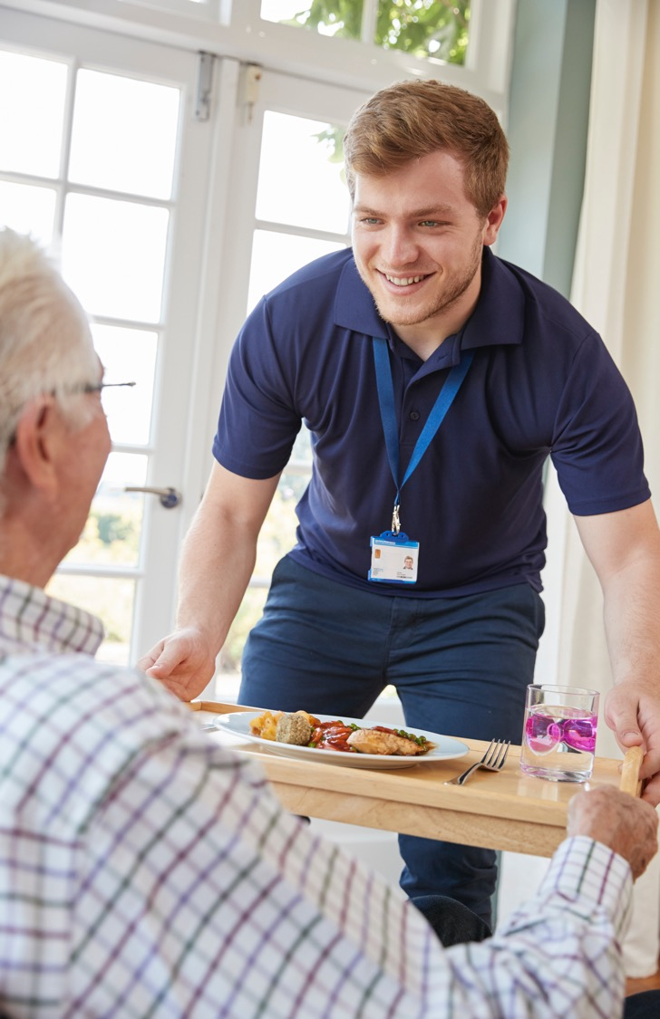
Want more information?
Contact
(add contact information here)
Notes:
Sound interesting?
Feel free to contact me at ADD CONTACT INFO HERE
GO TO NEXT SLIDE

Slide 15

Thank You!
Notes:
Thanks for being here
I’m happy to answer any questions!

