Slide 2


2025 Benchmarking Survey Updates
Molly Wylie, M.S., Research Associate, LeadingAge LTSS Center @UMass Boston
Amanda Young, PhD, Edenwald Senior Living & MAL Consulting LLC

Slide 3
CCaH Benchmarking: How Did We Get Here?
2016–2017
Initial provider discussions about standardized data collection
2017–2023
Provider workgroups to develop and finalize initial list of benchmarking questions
2018
First benchmarking survey distributed to 8 programs
2023
Providers partner with LeadingAge to establish neutral third-party data repository
2024-Now
Ongoing data collection (~45 programs), dissemination, and workgroup efforts

Slide 4
2025 Benchmarking Survey: What Did We Do?
54-question online survey
Program and member characteristics, outreach and marketing, member services and outcomes
Survey disseminated to 45 providers in January 2026
Data collected January – March 2026
Maintained updated list of provider contacts for accurate survey distribution

Slide 5
What Data Did We Collect?
  Program Profile
    Years in operation, market area(s), # of current full-time, part-time, and wellness coordination staff, # of plans offered, name of the CRM/EHR system used, monthly fee increases for the past 5 years
  Member Demographics
    Age, gender, marital status, identify as LGBTQ+, race/ethnicity, assets, length of membership
  Program Outreach and Marketing
    Marketing budget, new inquiries, new members, seminars/webinars, medically or financially denied, # of touchpoints from inquiry to application, top 3 lead sources
  Member Services and Outcomes
    # of members with LTC insurance, touchpoints between wellness coordinators and members, # of members using PERS, adult day, home care, AL, memory care, skilled nursing, hospitalizations, readmissions, short-term care, long-term care

Slide 6
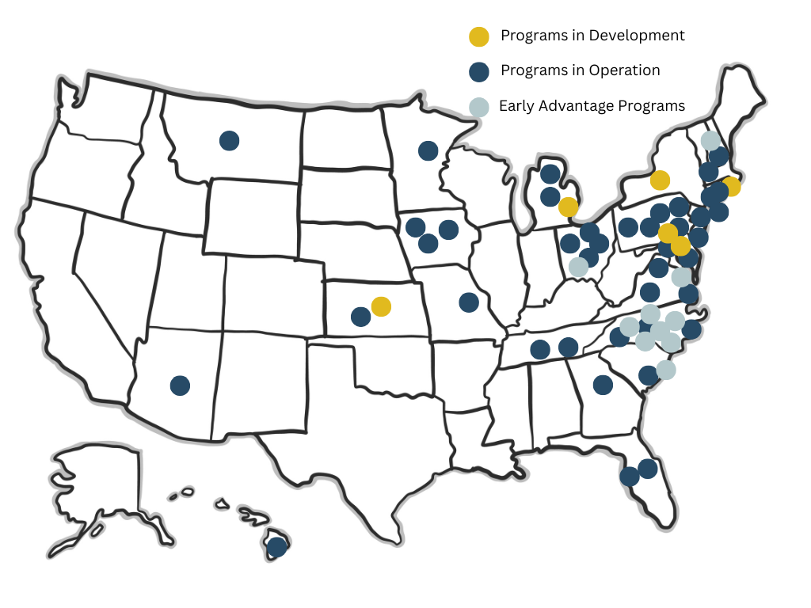
Traditional/Hybrid/ CC only Programs: 41
EA Programs: 11

Slide 7
Overview and Participating Programs
•Total of 31 programs participated in the benchmarking survey.
•Average years in operation was 12 with the range of 0-36 years.
•Average number of current members for a program: 155*
•Total number of current members represented in data: 6,664
•Total number of contracts sold through life of programs: 11,991
• *Outlier data removed

Slide 8
Average of 5 full-time and 2 part-time staff
Average of 3 Wellness/Care Coordinators per program with an average WC/CC member ratio of 57:1*
Most programs offer 3 or 4 plan options plus a care coordination only option.
Staff, Plans, and Oversight
Majority of programs reported state oversight by their Department of Insurance.

Slide 9
Software

Slide 10
Annual Adjustments to Monthly Fee
2021
3.5%
2024
4.25%
2025
4%
2023
4.5%
2022
4%

Slide 11
Marketing
Average Marketing Budget
$187,407 annually
Average marketing cost per lead = $747.00
Per Member = $6,484.00
Top Lead Sources
Direct Mail
Average number of households on mailing list is 45,941
Households receive an average of 3 mailings per year.
Referrals and Word of Mouth- Members, Professionals, Sponsoring LPC/CCRC

Slide 12
Seminars
29
263
Average seminars/webinars per year
Average number of attendees in 2025

Slide 13
Leads
Average # of new inquiries = 226
Average # of home visits/appointments = 81
Average # of days from inquiry to application = 140

Slide 14
Conversion Rates
Mailer to seminar = 0.6%
Seminar to home visit/appointment = 28%
Home visit/appointment to application = 56%
Application to membership = 74%
Home visit/appointment to membership = 42%
Percent of seminar attendees converted to members = 11.5%

Slide 15
Applicants
Number of applicants per year = 32*
Less than 1% were denied because of financial reasons
An average of 17% of applicants were medically denied
An average of 19% had Long-Term Care Insurance
An average of 10% withdrew their application

Slide 16
New Membership
21*
76 years
Average number of new members
Average age at enrollment
Range of 69-82

Slide 17
Current Member Demographics
Average age of current membership is 80 years old
Median assets $2.2M
*Including home value
60% female
40% male
71% are married
22% single females
8% single males
38% married females
32% married males
96% White
2.1% Asian/Pacific Islander
1.4% Black
0.3% Hispanic
1.3% identify as LGBTQ+

Slide 18
Terminations
3.4%* of members terminate membership for a reason other than death or bridge into a community

Slide 19
Member
Hospitalizations
5.5% of members were hospitalized in 2025
Top 3 reasons for hospitalizations were falls, planned surgeries, and illness/infections
Hospital readmission rate was 8.6% in 2025 (Average Medicare readmission 14.6%)
Common reasons for readmissions were infection, surgery complications, urinary issues

Slide 20
10% utilizing home care services
1% utilizing assisted living/memory care
0.52% utilizing skilled nursing
0.23% utilizing adult day services
24% utilizing Personal Emergency Response Systems
Top reasons for short-term care services were falls with injuries and scheduled surgeries
Care Utilization
Top reasons for long-term care were cognitive and/or mobility decline

Slide 21
Care Costs
$17 million
$2,557.10
$ spent on member care in 2025
Average care cost per member

Slide 22
Trends in Member Data Over Time
Average # of applicants has remained between 29-32 per year
% of males and females remains consistent; % single females declined (29% to 22%)
Median assets have steadily increased to over $2 million
Average # of new members has decreased slightly, but stayed between 21-25
Average age of enrollment was 76 in all years except 2023
% of married individuals increased from 61% in 2018 to 71% in 2025

Slide 23
Trends in Marketing Data Over Time
Average marketing budgets increased $20k from 2024-2025
Average # of days from inquiry to application decreased slightly, but still averages ~5 months
Average marketing cost per member remained in the $6ks
Number of households receiving mailers decreased from $52k to $45k
Seminar attendees and inquiries dropped in 2025 to under 300

Slide 24
Trends in Care Data Over Time
Medical denials stayed between 15-17%
Wellness Coordinator/Care Coordinator ratio decreased in 2025 from 71:1 to 57:1
The prevalence of LTCi decreased from average of 38% of applicants to 19% in 2025
Hospital readmission rates have stayed between 5-9%
Home care utilization has stayed around 10%; AL/MC decreased in 2025; SNF slightly increased but remains < 1%

Slide 25
Value of Benchmarking Data
Educate potential members: making the case with facts and data
Inform program strategy: target appropriate members, understand sales conversion rates, promote buy-in from board
Learning opportunity for new and emerging providers: sales cycles, HCBS providers, program size

Slide 26
The Future of CCaH Research
Descriptive mixed-methods studies: operationalize the value of care coordination; interview members to assess satisfaction and needs
Evaluate outcomes: Hospital readmissions, facility-based care utilization, Medicare spending
Grant funding: NIH (e.g., R03, R21), Donaghue Foundation, Research Institute for Home Care
Notes:
Amanda for Leadership Academy Action Learning Project working on – developing standards of practice for care coordination in CCaH. What is the intervention of CCaH?

Slide 27
Questions?
Want to get involved?
Want to send us updated contact info?
Email Molly Wylie mwylie@leadingage.org

